Slide 1
Artificial Intelligence

Slide 2
Artificial Intelligence
The paper intends to provide an accessible, scientifically and technologically accurate portrayal of the current state of AI and its potential.

Slide 3
Artificial intelligence in daily life
As AI is becoming commonplace in society, it is important to explore its possible applications across different industries. AI applications in transportation, such as autonomous vehicles, will require robust physical hardware and significant data resources. AI in the home and service robots can be enhanced by combining AI with mechanical innovations. The widespread adoption of AI in transportation has been facilitated by advances in data collection and connectivity. As AI continues to evolve, it is likely to bring significant social, ethical, and policy implications, and it is important for society to adapt to these changes.

Slide 4
Healthcare: "AI's promise in healthcare"
According to a report by McKinsey & Company, artificial intelligence (AI) has the potential to improve health outcomes and quality of life for millions of people in the coming years. AIbased applications in healthcare could include clinical decision support, patient monitoring and coaching, automated devices to assist in surgery or patient care, and management of healthcare systems. However, the report notes that technical constraints, high costs, and regulatory obstacles are limiting the commercial opportunities for AI in healthcare. To realize the full potential of AI in healthcare, improvements in humancomputer interaction methods and data collection and analysis are needed.

Slide 5
Key Phrase: "Artificial Intelligence"
The paper examines how artificial intelligence (AI) will transform our cities over the next fifteen years. Three domains are identified as having the greatest potential for change: healthcare, education, and public safety and security. AI applications in these domains are expected to improve efficiency, productivity, and quality of life. However, the paper also notes challenges, including the need for robust data infrastructure, privacy protection, and effective humanAI collaboration.

Slide 6
Future of Work
The Brookings Institution has published a technology trends report, which forecasts how artificial intelligence will impact US cities in the near future. The report examines AI's potential impact on transportation, crime, emergency response, the economy and employment.

Slide 7
Key Phrase: AI and the Future of Work
Digital technologies have been affecting workers more in the skilled middle than the very lowestskilled or highest skilled work. AI is also creeping into high end of the spectrum, including professional services not historically performed by machines.

Slide 8
Entertainment
The explosive growth of the internet and AI has redefined the essentials of daily life. Apps such as WhatsApp and Snapchat enable smartphone users to remain constantly in touch. Specialized devices, such as Amazon’s Kindle have also redefined the essentials of longcherished pastimes.

Slide 9
Artificial Intelligence (AI) in Entertainment
Artificial intelligence (AI) is not new but its application has been increasing in the last few years. There is now an AI algorithm for almost every problem. AI has helped in solving complex problems. AI has helped in improving the quality of life. AI has a number of advantages like accuracy, speed, efficiency and cost effectiveness. AI has its limitations like bias, errors, transparency and job displacement. Research should be directed toward understanding how to leverage the attributes of AI for individuals and society’s benefit.

Slide 10
Key Phrase: Benefits of Artificial Intelligence
Artificial intelligence (AI) is finally starting to deliver reallife benefits to earlyadopting companies, drawing billions of dollars in investment in 2016.

Slide 11
Key Phrase: Artificial Intelligence
Artificial intelligence can help companies automate processes and improve decisionmaking. AI can also help companies analyze large amounts of data and identify patterns and trends. The global AI market is expected to grow significantly in the coming years.

Slide 12
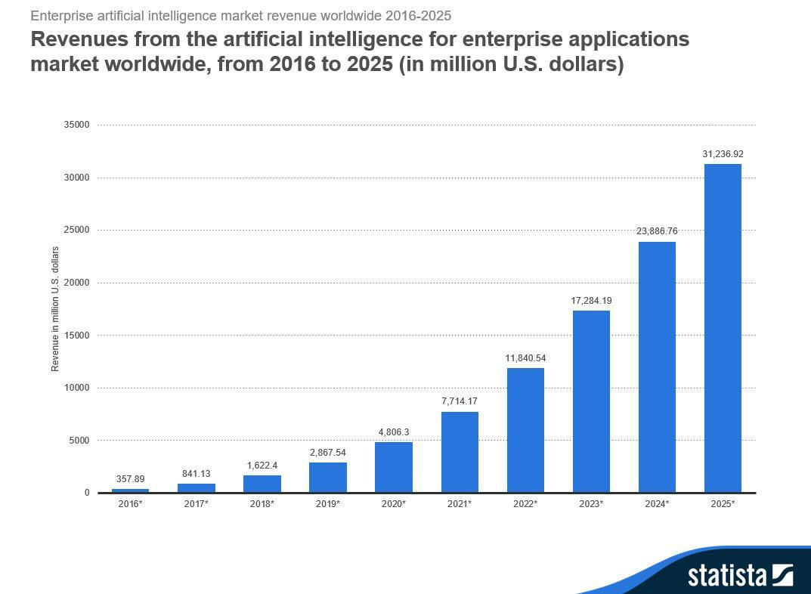

Slide 13
Artificial Intelligence (AI)
Artificial intelligence is expected to transform all industries, similar to the digital revolution and smartphone revolution. However, it also poses some risks, including the possibility of a superintelligent AI not having human emotions and being difficult to control. Experts believe that the most likely risks associated with AI are from autonomous weapons or from an AI being programmed to do something beneficial but developing a destructive method for achieving its goals.

Slide 14
Artificial Intelligence
Artificial intelligence has become a popular topic, but many people don't know what it is. This article defines artificial intelligence and highlights its functions.

